Slide 1
Text mining
Dr. Uros Godnov

Slide 2
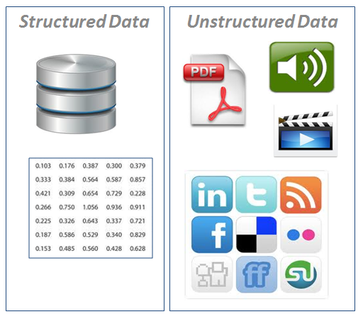

Slide 4
Why text mining?
85-90 percent of all corporate data is in some kind of unstructured form (e.g., text)
Unstructured corporate data is doubling in size every 18 months.

Slide 5
Why text mining?
Text Mining Concepts Benefits of text mining are obvious especially in text-rich data environments e.g.:
law (court orders)
academic research (research articles)
finance (quarterly reports)
medicine (discharge summaries)
marketing (customer comments)
Electronic communication records (e.g., Email) Spam filtering Email prioritization and categorization Automatic response generation

Slide 6
Concepts
Bag of words concepts
NLP (natural language processing)

Slide 7
Concepts
Bag of words concepts
mostly used tehnique
every word is independet (mostly); there are exceptions (e.g. Naive Bayes)
stemming (tourist, tourists and tourism may be the same word)
Sentiment analysis (different lexicons)
Entities extraction
Topics identification (e.g. LDA algorithm)
NLP (natural language processing)
Uses dictionaries to learn (e.g. Stanford NLP)
a subfield of artificial intelligence and computational linguistics. the study of "understanding" the natural human language

Slide 8
Sentiment analysis
Lexicons
Simple→advanced
Simple (e.g. Liu&Hu): -1 negative, 0 neutral, +1 positive
Advanced (e.g. AFINN): -5<->5
Different emotions (e.g. NRC)
NO STEMMING!

Slide 9
Topic analysis
Key words
LDA
STEMMING!

Slide 10
Topic analysis
Key words
LDA
Document consist of topics
Topic consist of words

Slide 11
I like to eat broccoli and bananas.
I ate a banana and spinach smoothie for breakfast.
Chinchillas and kittens are cute.
My sister adopted a kitten yesterday.
Look at this cute hamster munching on a piece of broccoli.
LDA
Sentences 1 and 2: 100% Topic A
Sentences 3 and 4: 100% Topic B
Sentence 5: 60% Topic A, 40% Topic B
Topic A: 30% broccoli, 15% bananas, 10% breakfast, 10% munching, … (at which point, you could interpret topic A to be about food)
Topic B: 20% chinchillas, 20% kittens, 20% cute, 15% hamster, … (at which point, you could interpret topic B to be about cute animals)

Slide 12
Tools
Open source tools
R
Rapidminer
Commercial tools
SPSS (text mining model)
Semantria

Slide 13
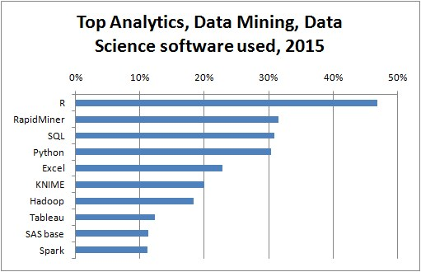
R vs. Rapidminer
R → programming oriented / Rapidminer→ GUI
R – more flexible and fastest growing statistical software in the world

Slide 14
Terms associated with text mining
Word frequency
Stemming
Term-document matrix / document-term matrix:
Removing stop words
Removing punctuations
Removing numbers
Removing whitespace

Slide 15
Why Rapidminer and not R?
Rapidminer is easier for you!

Slide 16
Rapidminer
Which extensions do we need for text mining?
Wordnet
Textprocessing
Aylien (make sure you are registered and got API key):
API
Commercial/free 1000 calls per day
Sentiment analysis

Slide 17
Configure Local repository
Create Local repository on a friendlier place on disk
Save process to repository

Slide 18
Identifying frequent words in phrases

Slide 19
Importing demo data
Import TA.csv into local repository
Transform date column
Save data as demodata

Slide 20
Creating process
Add following tasks:
Retrieve
Select attributes
Nominal to text
Process documents from data:
Tokenize
Transform cases
Filter tokens by length
Filter stopwords
Generate n-grams
Wordlist to data
Write Excel (thr)

Slide 21
Custom stoplist
Adding custom stoplist:
Filter stoplist(dictionary)
One word per line
First row doesn‘t count

Slide 22
Export result into excel and further analysis
Convert wordlist to
Write to excel
Analyze results with pivot table in Excel

Slide 23
Identifying association rules

Slide 24
Create document term matrix and rules creation
Document term matrix=create word vector
Vector creation→binary occurences (0/1)
Converting 0/1 to binominal
FP growth
Create association rules
Notes:
Create word vector

Slide 25
FP Growth
Calculates frequent itemsets (e.g. room-balcony)
Find min number of itemsets
Max number of retries
Min support
Notes:
Find min number of itemsets:
Min number of itemsets – tries to find that number regardless of min support
Max number of retires – how many times should algorithm lower the support (each time it lowers support fot 20 %)
Min support – in how many documents does itemset show itself

Slide 26
Create association rules
If→then rules
Support
Confidence
Notes:
Confidence - the probability of observing Y given X
Support - supp(X) of an itemset X is defined as the proportion of transactions in the data set which contain the itemset.

Slide 27
Sentiment analysis

Slide 28
Sentiment analysis – Part 1
Wordnet:
Wordnet dictionary
Princeton university
5000 words
It has to be wordnet 3.0!
Notes:
Wordnet – snemi ga dol (https://wordnet.princeton.edu/wordnet/download/current-version/#win, in sicer WordNet-3.0.tar.bz2
V process document taks dodaj na koncu open wordnet dictionary ter extract sentiment. Pokaži na folder dict
Pri process documentu obkljukaj add meta information, odstrani kljukico pri create word vector
Izhod, da vidiš sentiment, je EXA v result

Slide 29
Sentiment analysis – Part 2
Custom extensions, e.g.: Aylien
Free plan (1000 API cals/day)
Sentiment analysis
Entity recognition
Hashtag recommender
Notes:
Naredi z multiply operatorjem
SELECT atributes → nominal to text → Filter example range → Multiply

Slide 30
Named entity recognition

Slide 31
Microsoft azure machine learning
NLP
organization names
personal names
locations
English sentences
Source (store in csv)
convert result in csv and download
further analysis in Excel

Slide 32
Documents similarity – preparing data
How are documents similar (e.g. fake reviews)
It uses TF-IDF:
Term frequency in a document: 0.3
Documents count: 500
Count of documents containig this word+1: 11
Inverse document frequency: 500/11=45.45
Log of inverse document frequency=1.66
Product:0.3*1.66=0.467 (relative importance of your word/phrase)

Slide 33
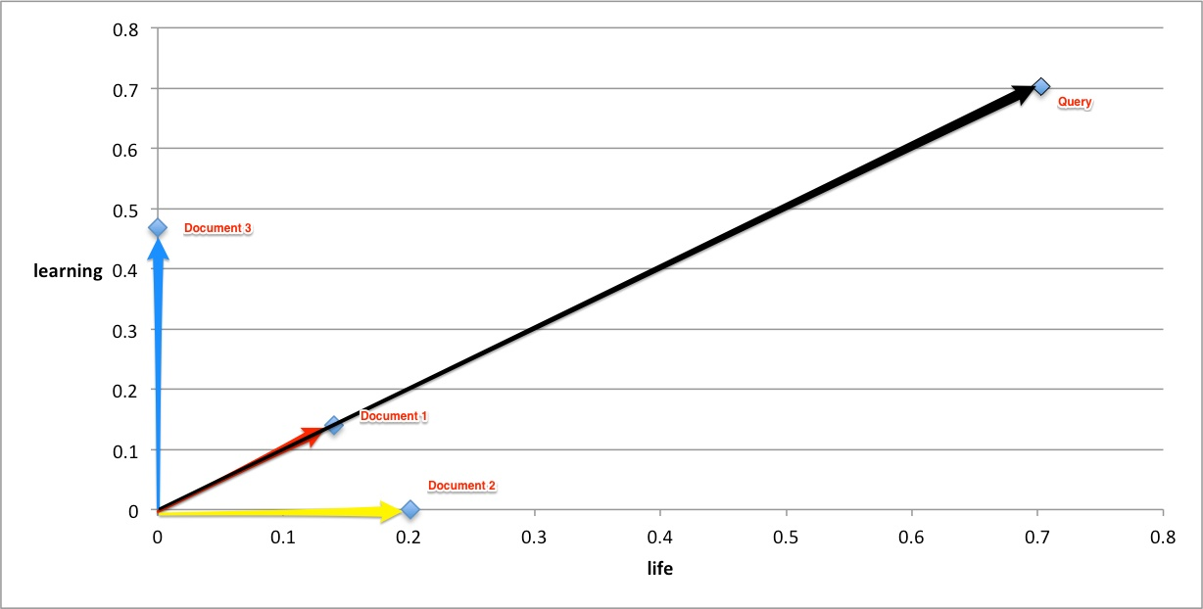
Documents similarity – calculating similarity
Different measures of similarity (e.g. Jaccard, Jaro-Winkler, cosine similarity)
Calculating angle between terms (smaller more similar)

